Slide 1
Smart Farming & Precision Agriculture in Kenya
Innovation in the IT Field: Technology transforming agriculture
Capstone Project
BBIT Grace Wanjiru Ndumbi
C027-01-1006/2022

Slide 2
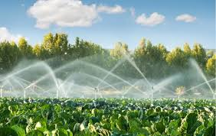
What Is Smart Farming?
• Use of digital technology in farming • Monitors crops & soil conditions • Helps plan decisions accurately • Improves farming efficiency • Uses sensors, drones, data tools

Slide 3
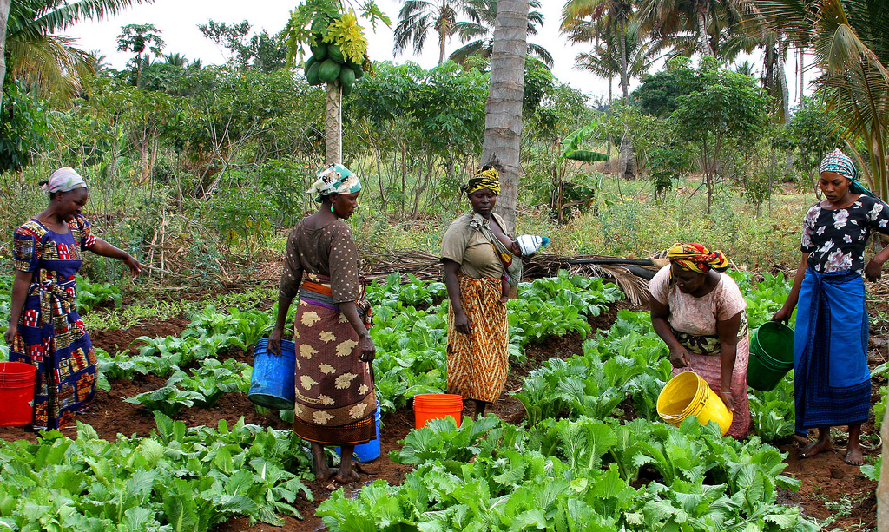
Agriculture in Kenya
• Major sector for economy • Source of food & income • Employs large portion of population • Faces climate & resource challenges

Slide 4

Key Technologies
• IoT soil & moisture sensors • Drones for crop monitoring • GPS & satellite imagery • Mobile apps & analytics

Slide 5
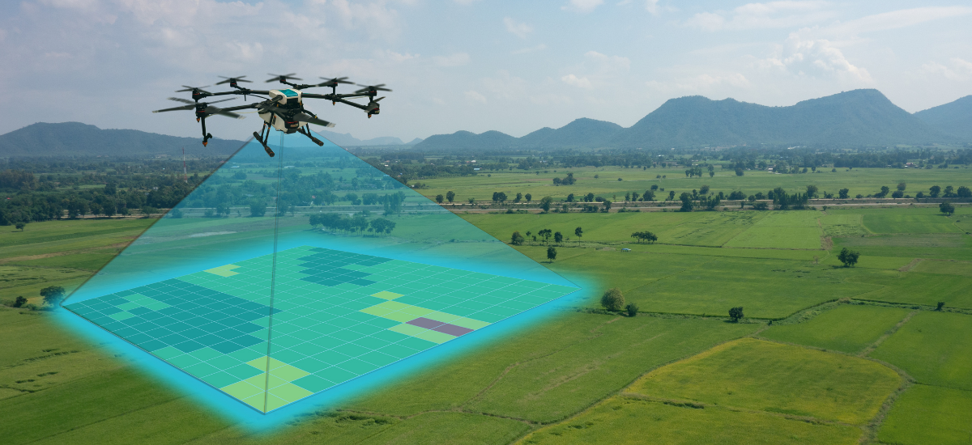
IoT & Sensors
• Real-time soil data • Moisture & nutrient monitoring • Improves irrigation planning • Saves water & inputs

Slide 6
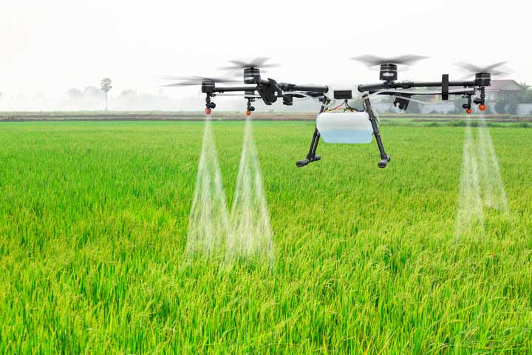
Drones in Farming
• Aerial crop inspection • Detects pest & disease early • Helps plan spraying tasks • Reduces time and cost

Slide 7
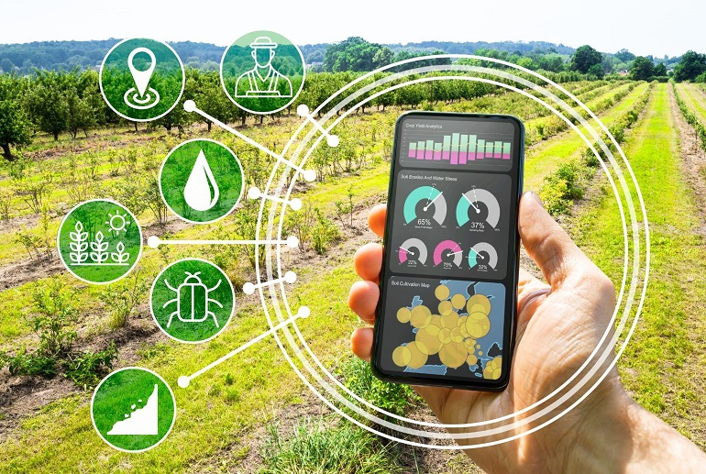
Data & Decisions
• Data collected from tools • Analyzed by analytics software • Provides farming insights • Guides irrigation & input use

Slide 8
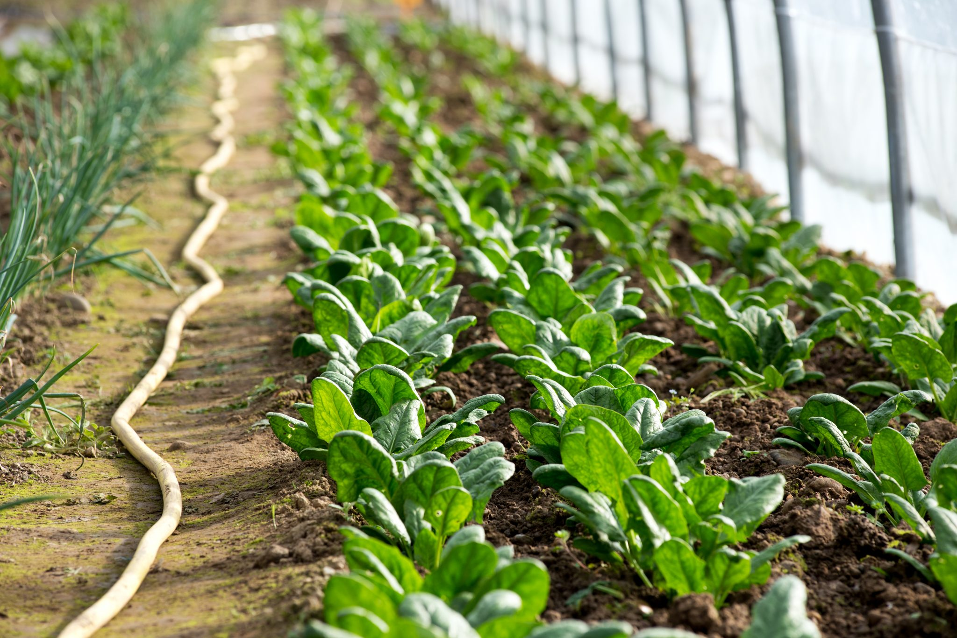
Impact in Kenya
• Better crop productivity • Less waste of resources • Faster problem detection • Early decision support

Slide 9
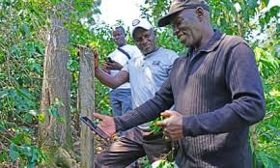
Kenyan Examples
• Tech adoption by farmers • Sensor systems in farms • Drones used for surveys • Mobile tools connect farmers

Slide 10
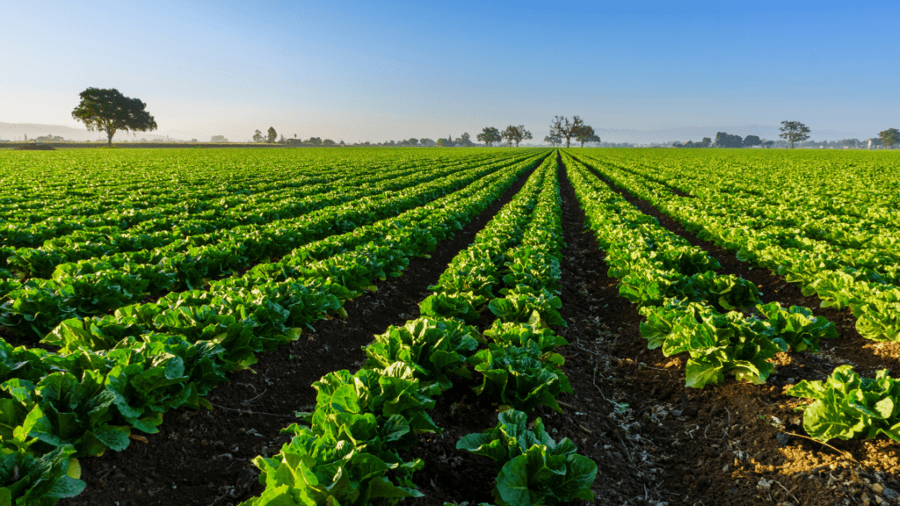
Benefits of Smart Farming
• Increased crop yields • Efficient resource use • Reduced environmental impact • Better market data access

Slide 11
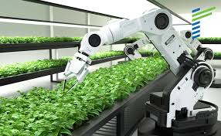
Challenges in Smart Farming
• High equipment costs • Limited rural internet • Need for tech training • Adoption is still growing

Slide 12

Growth Opportunities
• Mobile-based tools expansion • Government support programs • Agritech startups emerging • Youth involvement increases

Slide 13
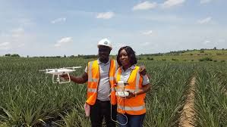
Youth & Tech
• New jobs for youth • Data tech & support roles • Skills grow with farming tech • Encourages innovation

Slide 14
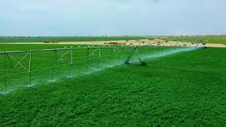
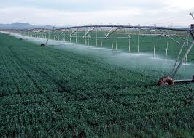
Food Security
• Stable crop production • Efficient use of water & inputs • Early problem identification • Supports community food needs

Slide 15
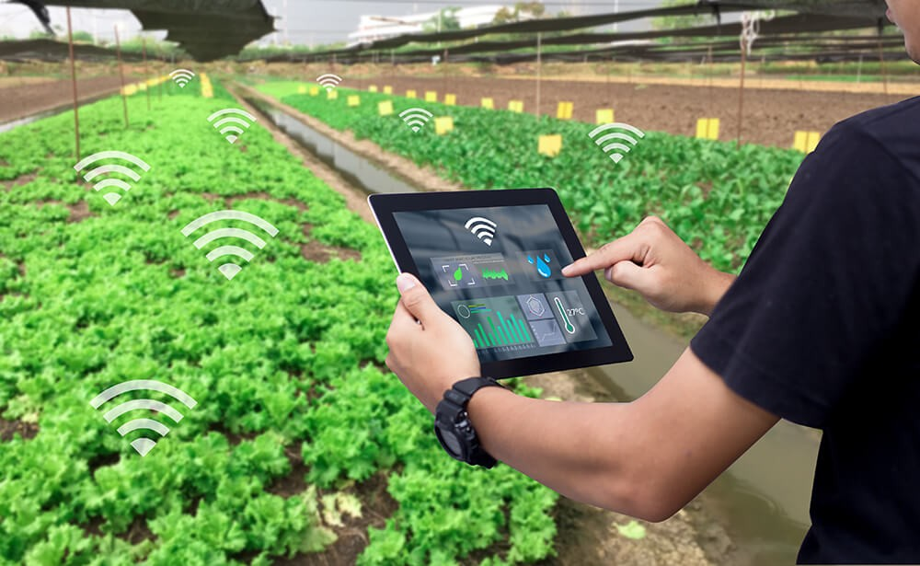
Conclusion
• Smart farming boosts productivity • Tech improves decision-making • Kenya benefits from innovation • Continued growth is possible

Slide 16
Thank you for listening

